Slide 1
Financial Analysis of Top 500 Companies in India
Presenter: AKANKSHA KUMARI

Slide 2
Executive Summary
Objective: This report analyzes the market capitalization and quarterly sales of the top 500 companies in India to identify key trends and insights.
Key Findings:
Analyzing market capitalization and sales data.
Highlight top companies and sectors.

Slide 3
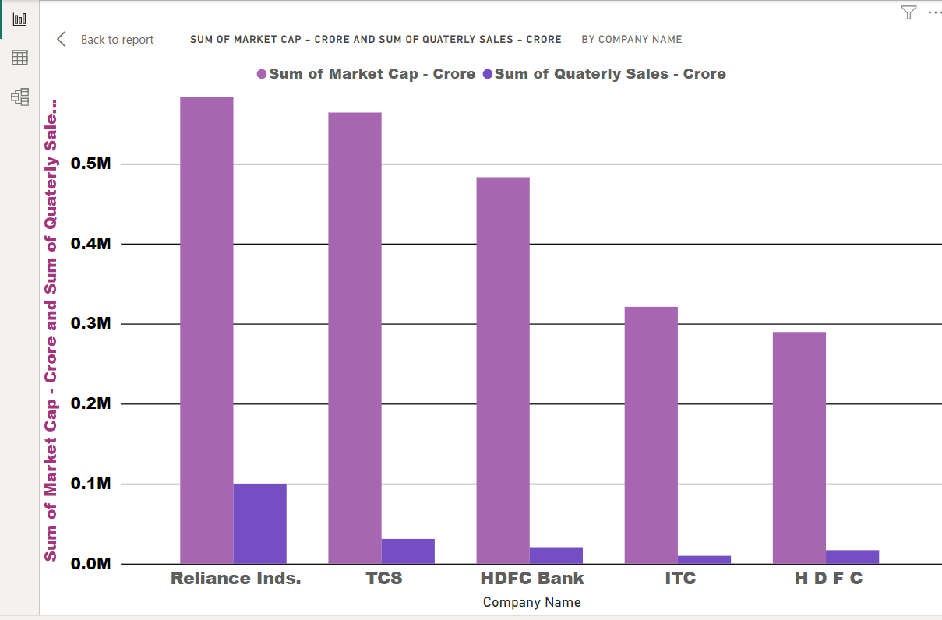

Slide 4
Key Metrics Analysis
Market Capitalization:
Average Market Cap: ₹31,300.97 Crore.
Top 10 Companies: (Bar Chart of the top 10 companies by market capitalization, showing Reliance Industries at the top with ₹583,436.72 Crore).

Slide 5
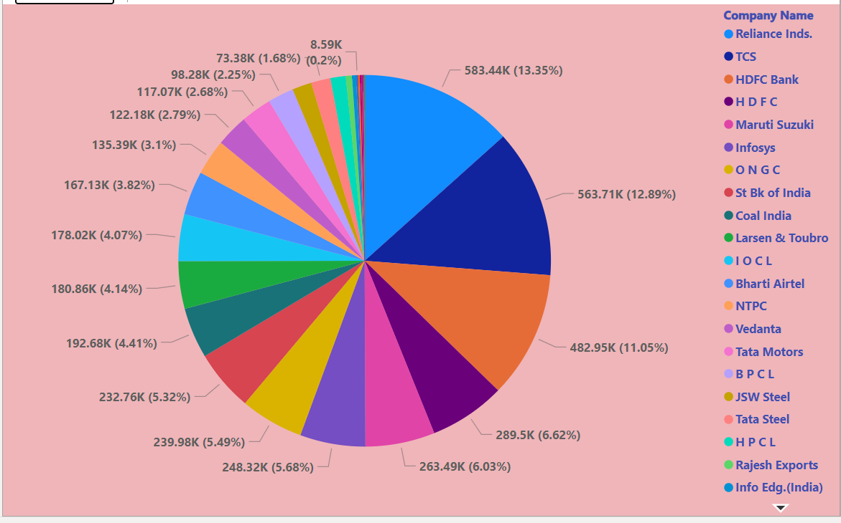
The technology sector leads in market capitalization, followed by the financial sector.

Slide 6
Segmentation and Comparative Analysis
Sector Analysis:
(Pie Chart showing market capitalization distribution across different sectors).
Key Insights: The technology sector leads in market capitalization, followed by the financial sector.

Slide 7
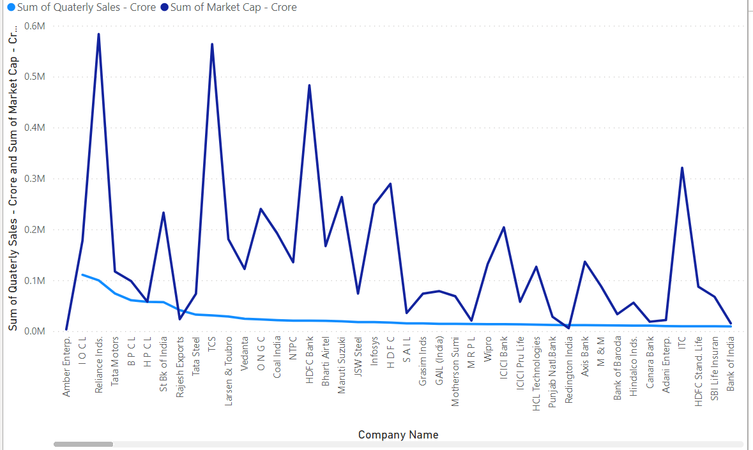

Slide 8
Insights and Recommendations
Insights:
Companies in the technology sector are showing robust market capitalization growth.
High market cap does not always correlate with high quarterly sales.
Recommendations:
Investors should consider diversifying into sectors with consistent growth in market capitalization and sales.

Slide 9
At 5,83,436.72, Reliance Inds. had the highest Sum of Market Cap - Crore and was 101.53% higher than H D F C, which had the lowest Sum of Market Cap - Crore at 2,89,497.37.﻿
Sum of Market Cap - Crore and total Sum of Quaterly Sales - Crore are positively correlated with each other.﻿
Reliance Inds. accounted for 26.04% of Sum of Market Cap - Crore.
The analysis provides a snapshot of the financial performance of the top companies in India.
Future reports could include year-over-year growth analysis for deeper insights.

Slide 10
Conclusion
The analysis provides a snapshot of the financial performance of the top companies in India.
Future reports could include year-over-year growth analysis for deeper insights.

